Slide 1

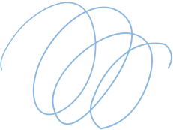


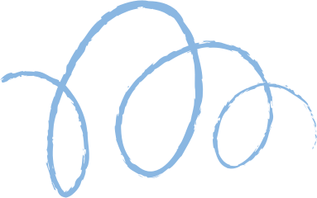









BrainStation
Project
Presented by Madhuja Mitra

Slide 2
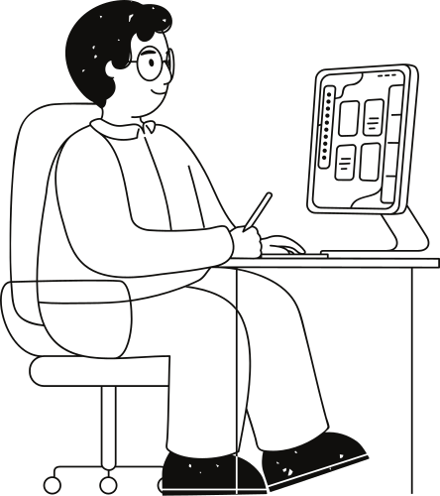
About Me
Software Engineer with hands-on
experience in full-stack technologies.
Highly adaptable and focused on
delivering scalable solutions to
complex problems. My career in
software development has enabled
me to master product design
principles and deliver scalable
solutions to complex problems.

Slide 3

Origin of the creative idea
The origin of the idea stems from personal experiences of applying to numerous jobs without receiving updates, along with observations on platforms like LinkedIn where thousands of individuals apply for the same job. This inefficiency not only wastes the time of both applicants and recruiters but also highlights the need for a more effective and streamlined hiring process. The project aims to address these challenges by introducing a solution that prioritizes quality applications, enhances communication, and optimizes the recruitment experience for all parties involved.

Slide 4
01.
Streamlined process: Emphasizes quality over quantity, ensuring recruiters efficiently review applications.
Project vision and mission
02.
Quick decisions: Facilitates faster hiring decisions, reducing delays in the recruitment process.
03.
Better matches: Enhances employer-candidate alignment for improved hiring outcomes.

Slide 5
Ideation process
01
02
03
04
Recognize the challenges faced by both job seekers and recruiters in the current recruitment process, such as overwhelming numbers of applications and inefficiencies in reviewing them.
Generate ideas to address the identified problems, considering factors like automation, technology integration, and process optimization.
Assess the practicality and viability of each idea based on factors like resources, technology requirements, and potential impact on users.
Iterate on the selected idea, refining its features, functionality, and user experience through feedback, research, and prototyping to ensure it effectively addresses the identified problem.

Slide 6

Final reflections and future steps
Introduce a feedback system where both candidates and recruiters can provide feedback after interviews, enhancing the overall process.
Increase the job application limit from 10 to 50 to accommodate larger companies or more popular job postings.
Enable users to sign in with their social media accounts and share job postings across their networks.
Use AI to automatically match candidate resumes with job requirements, improving the efficiency of the recruitment process.
More you can read on : https://github.com/madhujamitra/Capstone-project/blob/main/README.md

Slide 7
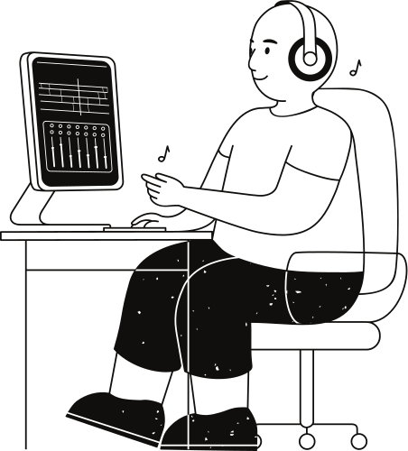
Thank you very much!

